Slide 1
UNIT IV Parallelism

Slide 2
Contents
Parallelism
Need for parallelism
Types of Parallelism
Applications of Parallelism
Parallelism in Software
Instruction level parallelism
Data level parallelism
Challenges in Parallelism
Architecture of Parallel system
Flynn’s Classification
SISD , SIMD
MIMD, MIMD
Hardware Multi threading
Coarse grain Parallelism
Fine grain Parallelism
Uni-Processor and MultiProcessor
Muti-core Processor
Memory in multi-processor system
Cache Coherency in multi-processor system
MESI Protocol for multi-processor system

Slide 3
Parallelism
Executing two or more operations at the same time is known as parallelism.
Parallel processing is a method to improve computer system performance by executing two or more instructions simultaneously
A parallel computer is a set of processors that are able to work cooperatively to solve a computational problem.
Two or more ALUs in CPU can work concurrently to increase throughput
The system may have two or more processors operating concurrently

Slide 4
Goals of parallelism:
To increase the computational speed (ie) to reduce the amount of time that you need to wait for a problem to be solved
To increase throughput (ie) the amount of processing that can be accomplished during a given interval of time
To improve the performance of the computer for a given clock speed
To solve bigger problems that might not fit in the limited memory of a single CPU

Slide 5
Applications of Parallelism
Numeric weather prediction
Socio economics
Finite element analysis
Artificial intelligence and automation
Genetic engineering
Weapon research and defence
Medical Applications
Remote sensing applications

Slide 6
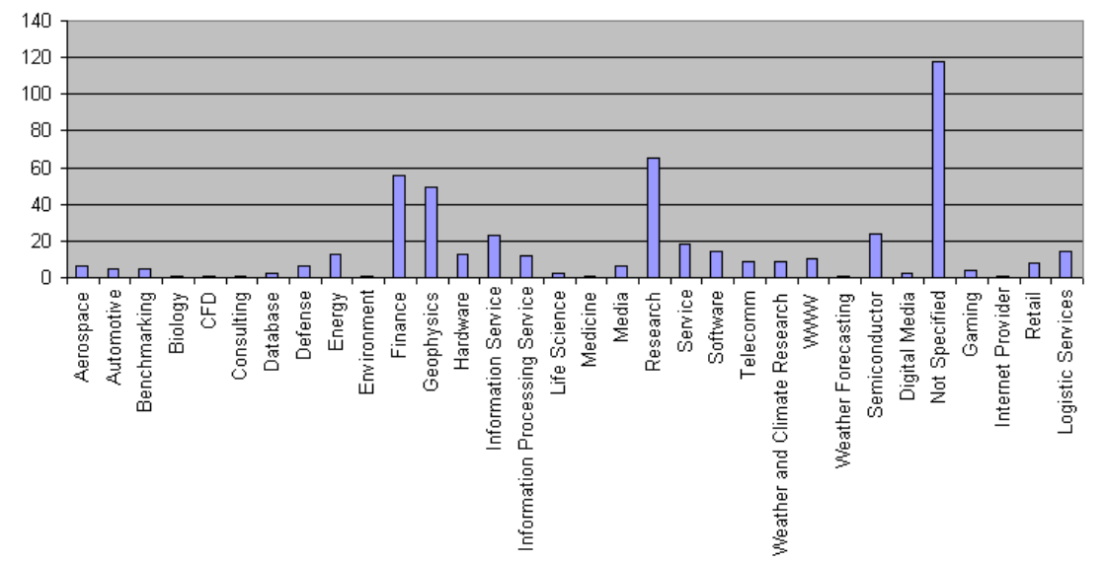
Applications of Parallelism

Slide 7
Types of parallelism
1. Hardware Parallelism
2. Software Parallelism
Hardware Parallelism :
The main objective of hardware parallelism is to increase the processing speed. Based on the hardware architecture, we can divide hardware parallelism into two types: Processor parallelism and memory parallelism.
Processor parallelism
Processor parallelism means that the computer architecture has multiple nodes, multiple CPUs or multiple sockets, multiple cores, and multiple threads.
Memory parallelism means shared memory, distributed memory, hybrid distributed shared memory, multilevel pipelines, etc. Sometimes, it is also called a parallel random access machine (PRAM). “It is an abstract model for parallel computation which assumes that all the processors operate synchronously under a single clock and are able to randomly access a large shared memory. In particular, a processor can execute an arithmetic, logic, or memory access operation within a single clock cycle”. This is what we call using overlapping or pipelining instructions to achieve parallelism.

Slide 8
Hardware Parallelism
One way to characterize the parallelism in a processor is by the number of instruction issues per machine cycle.
If a processor issues k instructions per machine cycle, then it is called a k-issue processor.
In a modern processor, two or more instructions can be issued per machine cycle.
A conventional processor takes one or more machine cycles to issue a single instruction. These types of processors are called one-issue machines, with a single instruction pipeline in the processor.
A multiprocessor system which built n k-issue processors should be able to handle a maximum of nk threads of instructions simultaneously

Slide 9
Software Parallelism
It is defined by the control and data dependence of programs.
The degree of parallelism is revealed in the program profile or in the program flow graph.
Software parallelism is a function of algorithm, programming style, and compiler optimization.
The program flow graph displays the patterns of simultaneously executable operations.
Parallelism in a program varies during the execution period .
It limits the sustained performance of the processor.

Slide 10
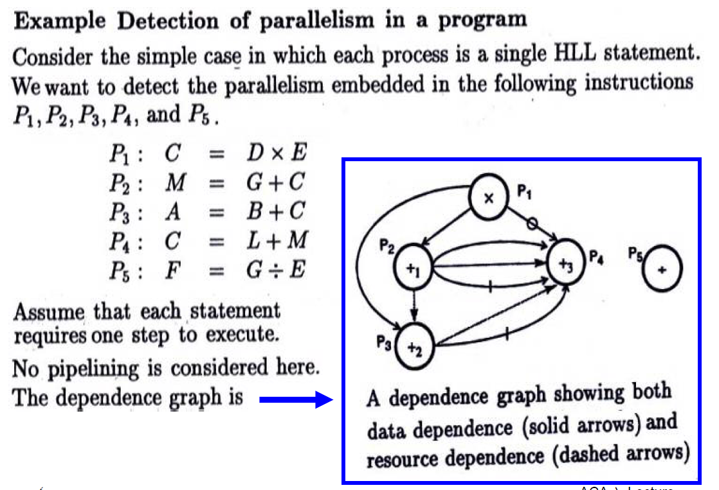

Slide 11
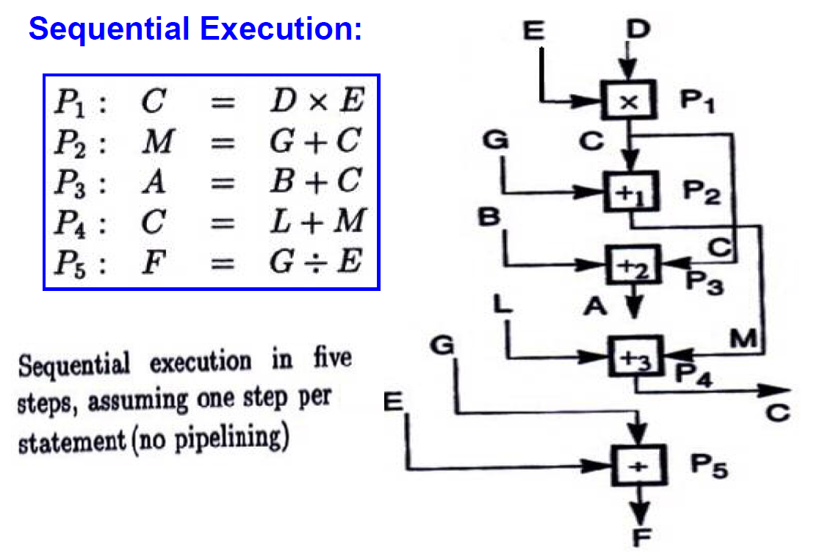

Slide 12
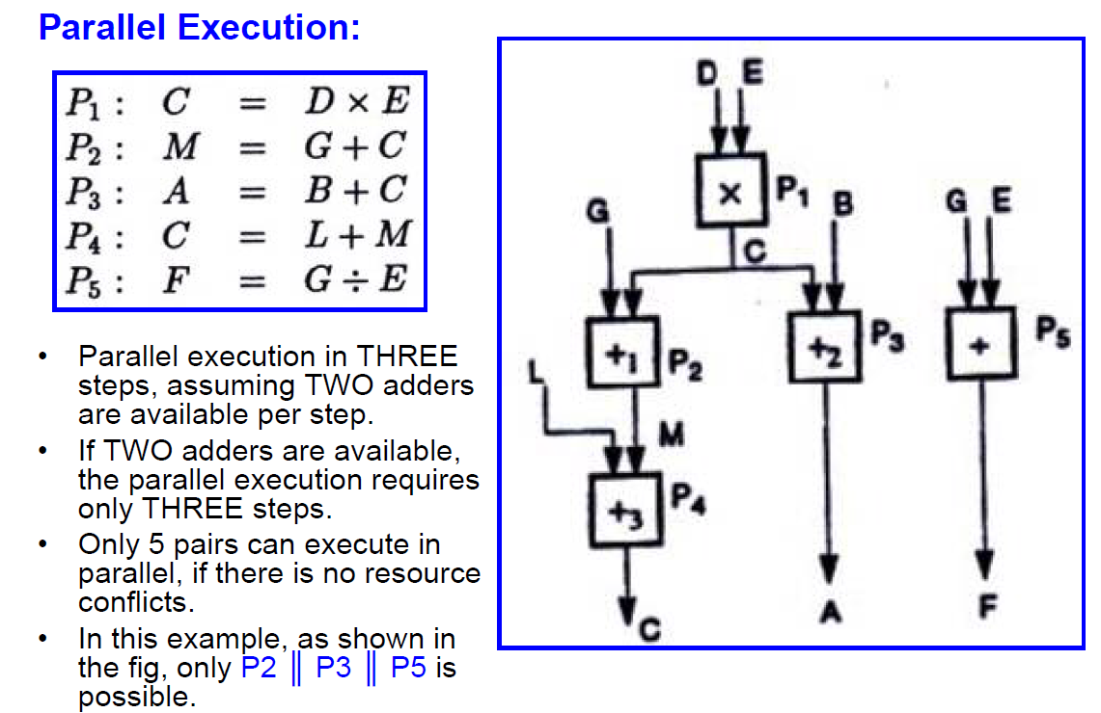

Slide 13
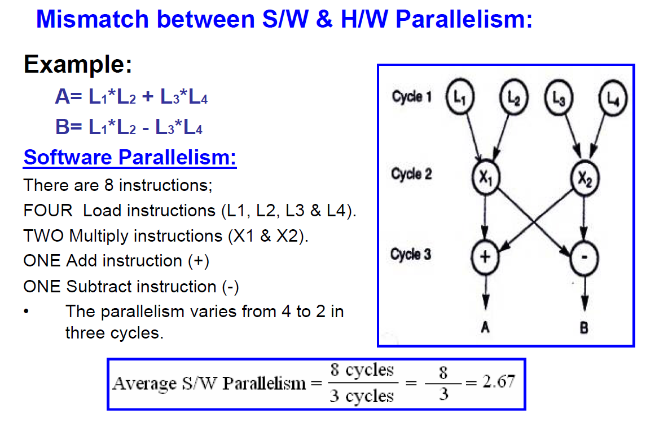

Slide 14
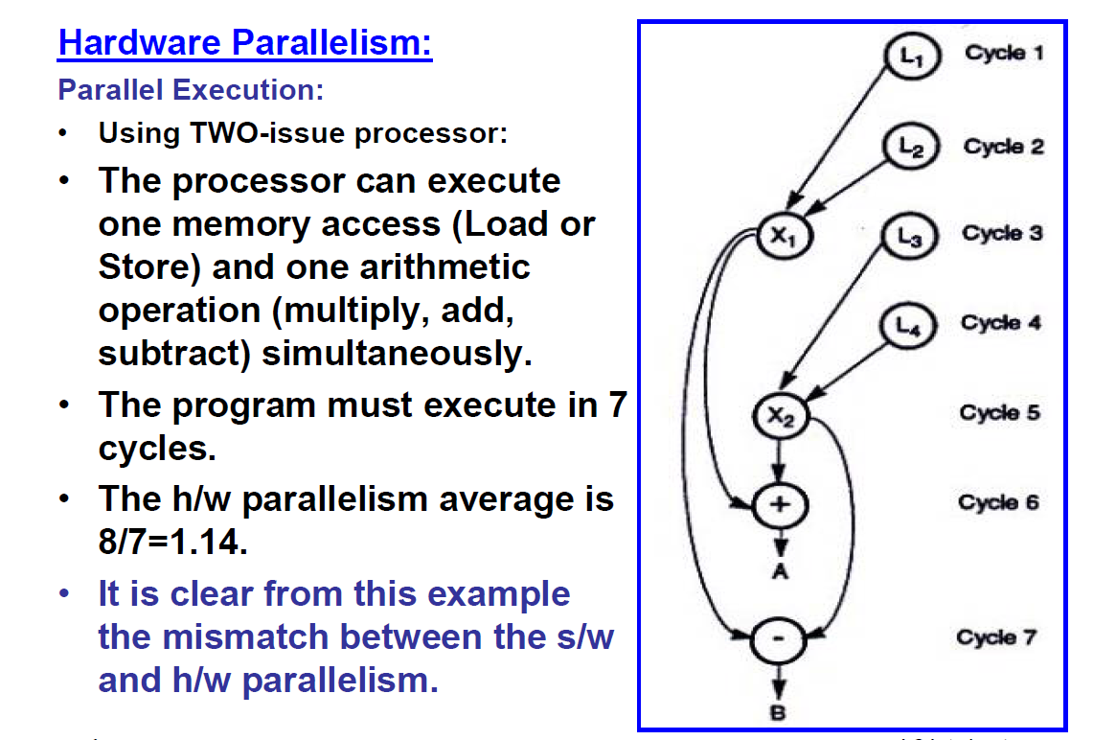

Slide 15
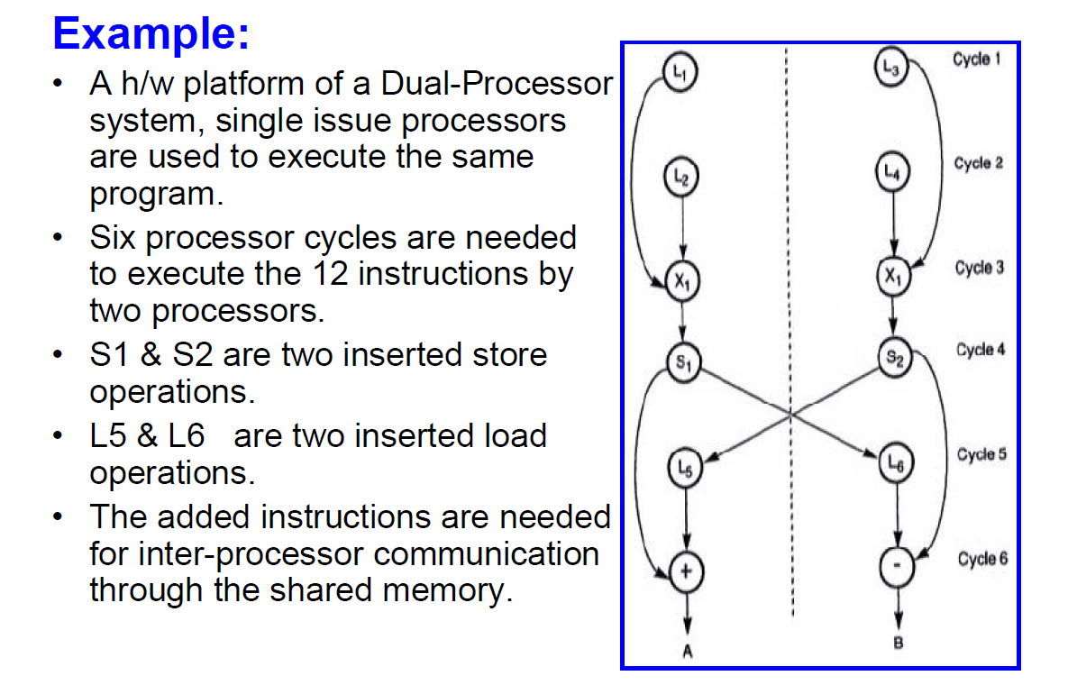

Slide 16
Software Parallelism - types
Parallelism in Software
Instruction level parallelism
Task-level parallelism
Data parallelism
Transaction level parallelism

Slide 17
Instruction level parallelism
Instruction level Parallelism (ILP) is a measure of how many operations can be performed in parallel at the same time in a computer program.
Parallel instructions are set of instructions that do not depend on each other to be executed.
ILP allows the compiler and processor to overlap the execution of multiple instructions or even to change the order in which instructions are executed.

Slide 18
Eg. Instruction level parallelism
Consider the following example
1. x= a+b
2. y=c-d
3. z=x * y
Operation depends on the results of 1 & 2
So ‘Z ‘ cannot be calculated until X & Y are calculated
But 1 & 2 do not depend on any other. So they can be computed simultaneously.

Slide 19
If we assume that each operation can be completed in one unit of time then theses 3 operations can be completed in 2 units of time .
ILP factor is 3/2=1.5 which is greater than without ILP.
A superscalar CPU architecture implements ILP inside a single processor which allows faster CPU throughput at the same clock rate.

Slide 20
Data-level parallelism (DLP)
Data parallelism is parallelization across multiple processors in parallel computing environments.
It focuses on distributing the data across different nodes, which operate on the data in parallel.
Instructions from a single stream operate concurrently on several data
Limited by non-regular data manipulation patterns and by memory bandwidth

Slide 21
DLP - example
Let us assume we want to sum all the elements of the given array of size n and the time for a single addition operation is Ta time units.
In the case of sequential execution, the time taken by the process will be n*Ta time unit
if we execute this job as a data parallel job on 4 processors the time taken would reduce to (n/4)*Ta + merging overhead time units.

Slide 22
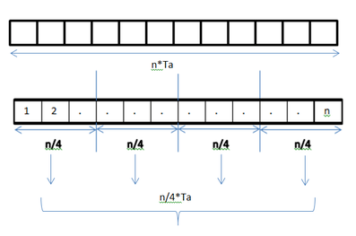
DLP in Adding elements of array

Slide 23
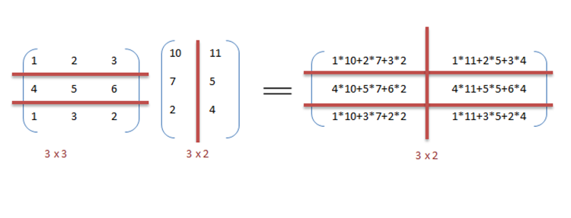
DLP in matrix multiplication
A[m x n] dot B [n x k] can be finished in O(n) instead of O(m∗n∗k ) when executed in parallel using m*k processors.

Slide 24
The locality of data references plays an important part in evaluating the performance of a data parallel programming model.
Locality of data depends on the memory accesses performed by the program as well as the size of the cache.

Slide 25
Flynn’s Classification
Was proposed by researcher Michael J. Flynn in 1966.
It is the most commonly accepted taxonomy of computer organization.
In this classification, computers are classified by whether it processes a single instruction at a time or multiple instructions simultaneously, and whether it operates on one or multiple data sets.

Slide 26
Flynn’s Classification
This taxonomy distinguishes multi-processor computer architectures according to the two independent dimensions of Instruction stream and Data stream.
An instruction stream is sequence of instructions executed by machine.
A data stream is a sequence of data including input, partial or temporary results used by instruction stream.
Each of these dimensions can have only one of two possible states: Single or Multiple.
Flynn’s classification depends on the distinction between the performance of control unit and the data processing unit rather than its operational and structural interconnections.

Slide 27
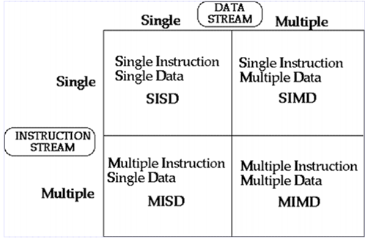
Flynn’s Classification
Four category of Flynn classification

Slide 28
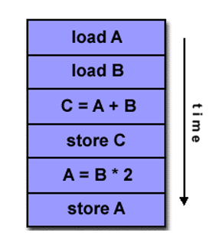

SISD
They are also called scalar processor i.e., one instruction at a time and each instruction have only one set of operands.
Single instruction: only one instruction stream is being acted on by the CPU during any one clock cycle.
Single data: only one data stream is being used as input during any one clock cycle.
Deterministic execution.
Instructions are executed sequentially.
SISD computer having one control unit, one processor unit and single memory unit.

Slide 29
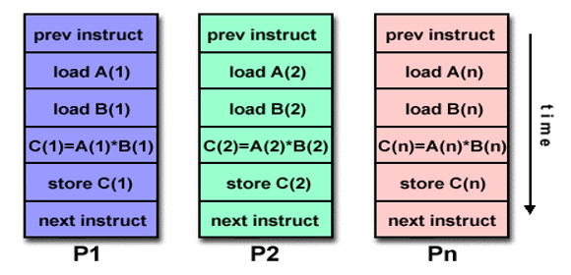
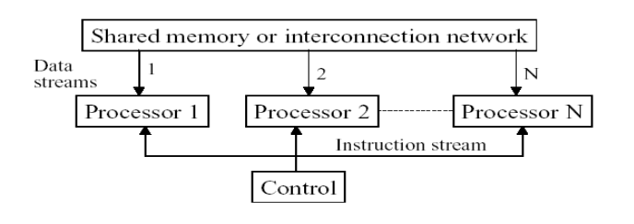
SIMD
A type of parallel computer.
Single instruction: All processing units execute the same instruction issued by the control unit at any given clock cycle .
Multiple data: Each processing unit can operate on a different data element as shown if figure below the processor are connected to shared memory or interconnection network providing multiple data to processing unit
single instruction is executed by different processing unit on different set of data

Slide 30
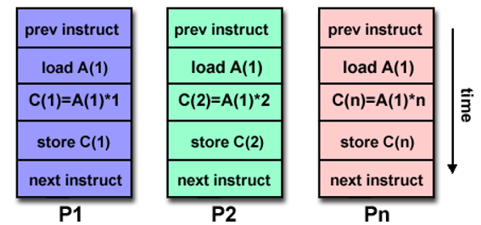
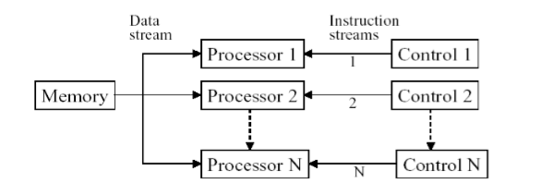
MISD
A single data stream is fed into multiple processing units.
Each processing unit operates on the data independently via independent instruction.
A single data stream is forwarded to different processing unit which are connected to different control unit and execute instruction given to it by control unit to which it is attached.
same data flow through a linear array of processors executing different instruction streams

Slide 31
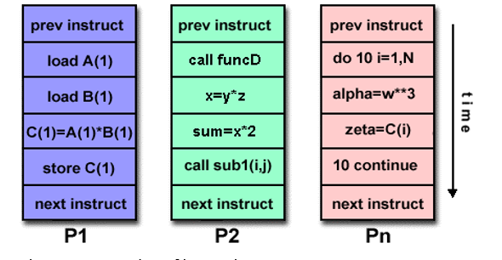
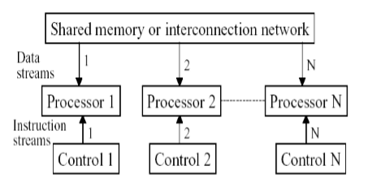
MIMD
Multiple Instruction: every processor may be executing a different instruction stream.
Multiple Data: every processor may be working with a different data stream.
Execution can be synchronous or asynchronous, deterministic or nondeterministic
Different processor each processing different task.

Slide 32
Hardware Multithreading
Hardware multithreading allows multiple threads to share the functional units of a single processor in an overlapping fashion to try to utilize the hardware resources efficiently.
To permit this sharing, the processor must duplicate the independent state of each thread. It Increases the utilization of a processor
For example, each thread would have a separate copy of register file and program counter. The memory itself can be shared through virtual memory mechanisms, which already support multi-programming.
In addition, hardware must support to change to a different thread relatively quickly. In particular, a thread switch should be much more efficient than a process switch, which typically requires hundreds to thousands of processor cycles while a thread switch can be instantaneous.

Slide 33
Fine grained multi threading
Fine-grained multithreading switches between threads on each instruction, resulting in interleaved execution of multiple threads.
This interleaving is often done in a round-robin fashion, skipping any threads that are stalled at that clock cycle.
To make fine-grained multithreading practical, processor must be able to switch threads on every clock cycle.
One advantage of fine-grained multithreading is that it can hide throughput losses that arise from both short and long stalls, since instructions from or threads can be executed when one thread stalls.
The primary disadvantage of fine-grained multithreading is that it slows down execution of individual threads, since a thread that is ready to execute without stalls will be delayed by instructions from or threads.

Slide 34
Coarse grained multi threading
Coarse-grained multithreading was invented as an alternative to fine-grained multithreading.
Coarse-grained multithreading switches threads only on costly stalls, such as last-level cache misses.
This change relieves need to have thread switching be extremely fast and is much less likely to slow down execution of an individual thread, since instructions from or threads will only be issued when a thread encounters a costly stall.
Drawback: it is limited in its ability to overcome throughput losses, especially from shorter stalls.
This limitation arises from pipeline start-up costs of coarse-grained multithreading. Because a processor with coarse-grained multithreading issues instructions from a single thread, when a stall occurs, pipeline must be emptied or frozen.
The new thread that begins executing after stall must fill pipeline before instructions will be able to complete. Due to start-up overhead, coarse-grained multithreading is much more useful for reducing penalty of high-cost stalls, where pipeline refill is negligible compared to stall time.

Slide 35
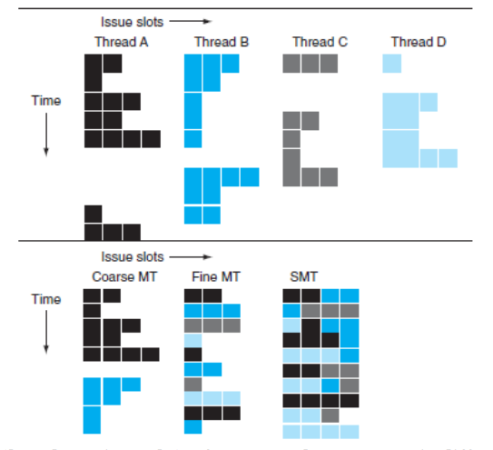
Comparison

Slide 36
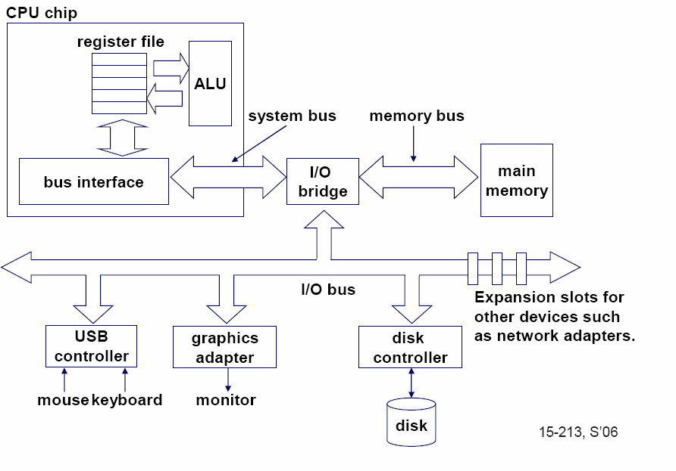
Single-core computer
36

Slide 37
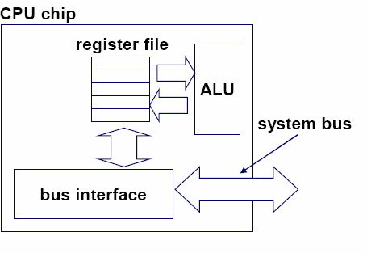
Single-core CPU chip
the single core
37

Slide 38
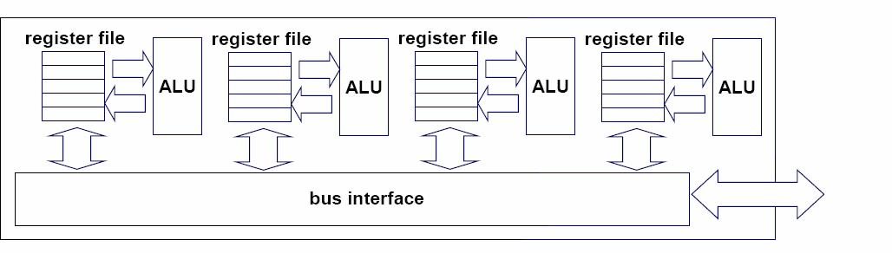
Multi-core architectures
Replicate multiple processor cores on a single die.
Core 1 Core 2 Core 3 Core 4
Multi-core CPU chip
4

Slide 39
Multi-core CPU chip
The cores fit on a single processor socket
Also called CMP (Chip Multi-Processor)
c o r e 1 | c o r e 2 | c o r e 3 | c o r e 4

Slide 40
The cores run in parallel
thread 1 thread 2 thread 3 thread 4
c
c
c
c
o
o
o
o
r e
r e
r e
r e
1
2
3
4

Slide 41
Within each core, threads are time-sliced (just like on a uniprocessor)
several threads
several threads
several threads
several threads
c
c
c
c
o
o
o
o
r e
r e
r e
r e
1
2
3
4

Slide 42
Memory in Multiprocessor System
Two architectures:
Shared common memory
Unshared Distributed memory.

Slide 43
Shared memory multiprocessors
Shared memory multiprocessors
A system with multiple CPUs “sharing” the same main memory is called Shared memory multiprocessor.
In a multiprocessor system all processes on the various CPUs share a unique logical address space.
Multiple processors can operate independently but share the same memory resources.
Changes in a memory location effected by one processor are visible to all other processors.
Shared memory machines can be divided into two main classes based upon memory access times: UMA , NUMA.

Slide 44
Uniform Memory Access (UMA)
Most commonly represented today by Symmetric Multiprocessor (SMP) machines.
Identical processors .
Equal access and access times to memory .
Sometimes called CC-UMA - Cache Coherent UMA. Cache coherent means if one processor updates a location in shared memory, all the other processors know about the update. Cache coherency is accomplished at the hardware level.
It can be used to speed up the execution of a single large program in time critical applications

Slide 45
Non-Uniform Memory Access (NUMA)
these systems have a shared logical address space, but physical memory is distributed among CPUs, so that access time to data depends on data position, in local or in a remote memory (thus the NUMA denomination)
•These systems are also called Distributed Shared Memory (DSM)architecture
Memory access across link is slower
If cache coherency is maintained, then may also be called CC-NUMA - Cache Coherent NUMA

Slide 46
The COMA model : The COMA model is a special case of NUMA machine in which the distributed main memories are converted to caches. All caches form a global address space and there is no memory hierarchy at each processor node.
Data have no specific “permanent” location (no specific memory address) where they stay and when they can be read (copied into local caches) and/or modified (first in the cache and then updated at their “permanent” location).

Slide 47
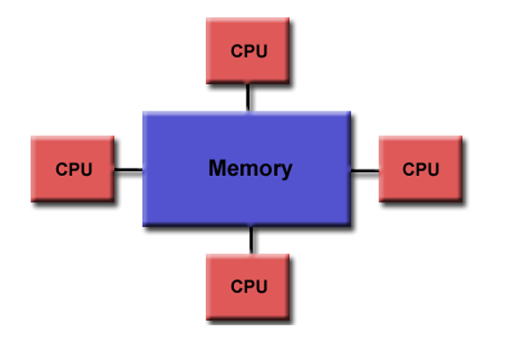
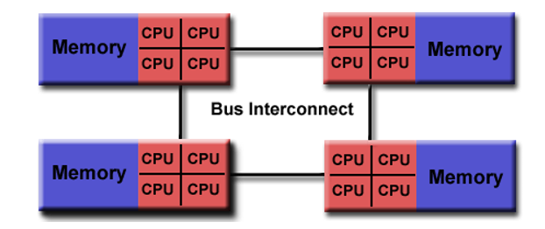
Shared Memory
Uniform Memory Access
Non-Uniform Memory Access

Slide 48
Distributed memory systems
Distributed memory systems require a communication network to connect inter-processor memory.
Processors have their own local memory.
Memory addresses in one processor do not map to another processor, so there is no concept of global address space across all processors.
Because each processor has its own local memory, it operates independently.
Changes it makes to its local memory have no effect on the memory of other processors. Hence, the concept of cache coherency does not apply.
When a processor needs access to data in another processor, it is usually the task of the programmer to explicitly define how and when data is communicated.
Synchronization between tasks is likewise the programmer's responsibility.

Slide 49
The memory hierarchy
If simultaneous multithreading only:
all caches shared
Multi-core chips:
L1 caches private
L2 caches private in some architectures and shared in others
Memory is always shared

Slide 50
“Fish” machines
hyper-threads
Dual-core
Intel Xeon processors
C O R E 1
C O R E 0
Each core is hyper-threaded
L1 cache L1 cache
L2 cache
Private L1 caches
Shared L2 caches
memory

Slide 51
Designs with private L2 caches
L1 cache | L1 cache
L2 cache | L2 cache
memory
L1 cache | L1 cache
L2 cache | L2 cache
L3 cache | L3 cache
memory
C O R E 1
C O R E 0
C O R E 1
C O R E 0
Both L1 and L2 are private
A design with L3 caches
Examples: AMD Opteron, AMD Athlon, Intel Pentium D
Example: Intel Itanium 2
32

Slide 52
Private vs shared caches?
Advantages/disadvantages?

Slide 53
Private vs shared caches
Advantages of private:
They are closer to core, so faster access
Reduces contention
Advantages of shared:
Threads on different cores can share the same cache data
More cache space available if a single (or a few) high-performance thread runs on the system

Slide 54
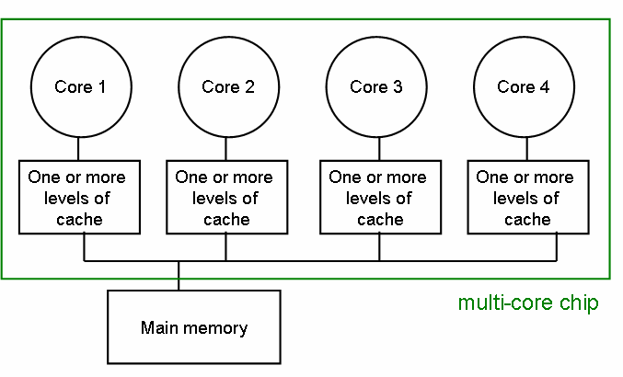
The cache coherence problem
Since we have private caches:
How to keep the data consistent across caches?
Each core should perceive the memory as a monolithic array, shared by all the cores

Slide 55
The cache coherence problem
Suppose variable x initially contains 15213
Core 1
Core 2
Core 3
Core 4
One or more levels of cache
One or more levels of cache
One or more levels of cache
One or more levels of cache
multi-core chip
Main memory x=15213

Slide 56
The cache coherence problem
Core 1 reads x
Core 1
Core 2
Core 3
Core 4
One or more levels of cache x=15213
One or more levels of cache
One or more levels of cache
One or more levels of cache
multi-core chip
Main memory x=15213

Slide 57
The cache coherence problem
Core 2 reads x
Core 1
Core 2
Core 3
Core 4
One or more levels of cache x=15213
One or more levels of cache x=15213
One or more levels of cache
One or more levels of cache
multi-core chip
Main memory x=15213

Slide 58
The cache coherence problem
Core 1 writes to x, setting it to 21660
Core 1
Core 2
Core 3
Core 4
One or more levels of cache x=21660
One or more levels of cache x=15213
One or more levels of cache
One or more levels of cache
multi-core chip
Main memory x=21660
assuming write-through caches
39

Slide 59
The cache coherence problem
Core 2 attempts to read x… gets a stale copy
Core 1
Core 2
Core 3
Core 4
One or more levels of cache x=21660
One or more levels of cache x=15213
One or more levels of cache
One or more levels of cache
multi-core chip
Main memory x=21660
40

Slide 60
Solutions for cache coherence
This is a general problem with multiprocessors, not limited just to multi-core
There exist many solution algorithms, coherence protocols, etc.
A simple solution:
invalidation-based protocol with snooping
41

Slide 61
Inter-core bus
Core 1
Core 2
Core 3
Core 4
One or more levels of cache
One or more levels of cache
One or more levels of cache
One or more levels of cache
multi-core chip
Main memory
inter-core bus
42

Slide 62
Invalidation protocol with snooping
Invalidation:
If a core writes to a data item, all other copies of this data item in other caches are invalidated
Snooping:
All cores continuously “snoop” (monitor) the bus connecting the cores.
43

Slide 63
Bus Snooping
Each CPU (cache system) ‘snoops’ (i.e. watches continually) for write activity concerned with data addresses which it has cached.• This assumes a bus structure which is ‘global’, i.eall communication can be seen by all.

Slide 64
The cache coherence problem
Revisited: Cores 1 and 2 have both read x
Core 1
Core 2
Core 3
Core 4
One or more levels of cache x=15213
One or more levels of cache x=15213
One or more levels of cache
One or more levels of cache
multi-core chip
Main memory x=15213
44

Slide 65
The cache coherence problem
Core 1 writes to x, setting it to 21660
Core 1
Core 2
Core 3
Core 4
One or more levels of cache x=21660
One or more levels of cache x=15213
One or more levels of cache
One or more levels of cache
sends
INVALIDATED
invalidation
multi-core chip
request
Main memory x=21660
assuming write-through caches
inter-core bus
45

Slide 66
The cache coherence problem
After invalidation:
Core 1
Core 2
Core 3
Core 4
One or more levels of cache x=21660
One or more levels of cache
One or more levels of cache
One or more levels of cache
multi-core chip
Main memory x=21660

Slide 67
The cache coherence problem
Core 2 reads x. Cache misses, and loads the new copy.
Core 1
Core 2
Core 3
Core 4
One or more levels of cache x=21660
One or more levels of cache x=21660
One or more levels of cache
One or more levels of cache
multi-core chip
Main memory x=21660

Slide 68
Alternative to invalidate protocol: update protocol
Core 1 writes x=21660:
Core 1
Core 2
Core 3
Core 4
One or more levels of cache x=21660
One or more levels of cache x=21660
One or more levels of cache
One or more levels of cache
UPDATED
broadcasts
multi-core chip
updated value
Main memory x=21660
assuming write-through caches
inter-core bus
48

Slide 69
Which do you think is better?
Invalidation or update?

Slide 70
Invalidation vs update
Multiple writes to the same location
invalidation: only the first time
update: must broadcast each write
(which includes new variable value)
Invalidation generally performs better: it generates less bus traffic

Slide 71
MESI Protocol
For Multiprocessor Systems

Slide 72
The MESI protocol is an Invalidate-based cache coherence protocol, and is one of the most common protocols which support write-back caches.
Write back caches can save a lot on bandwidth that is generally wasted on a write through cache.
There is always a dirty state present in write back caches which indicates that the data in the cache is different from that in main memory

Slide 73
MESI Protocol (2)
Any cache line can be in one of 4 states (2 bits)
Modified - The cache line is present only in the current cache, and is dirty - it has been modified (M state) from the value in main memory. The cache is required to write the data back to main memory at some time in the future, before permitting any other read of the (no longer valid) main memory state. The write-back changes the line to the Shared state(S).
Exclusive – The cache line is present only in the current cache, but is clean - it matches main memory. It may be changed to the Shared state at any time, in response to a read request. Alternatively, it may be changed to the Modified state when writing to it.
Shared – Indicates that this cache line may be stored in other caches of the machine and is clean - it matches the main memory. The line may be discarded (changed to the Invalid state) at any time
Invalid – Indicates that this cache line is invalid (unused).

Slide 74
Operation
A processor P1 has a Block X in its Cache, and there is a request from the processor to read or write from that block.
The second stimulus comes from other processors, which doesn't have the Cache block or the updated data in its Cache.
The bus requests are monitored with the help of Snoopers which snoops all the bus transactions.
Following are the different type of Processor requests and Bus side requests:
Processor Requests to Cache includes the following operations:
PrRd: The processor requests to read a Cache block.
PrWr: The processor requests to write a Cache block

Slide 75
Bus side requests are the following:
BusRd: Snooped request that indicates there is a read request to a Cache block made by another processor
BusRdX: Snooped request that indicates there is a write request to a Cache block made by another processor which doesn't already have the block.
BusUpgr: Snooped request that indicates that there is a write request to a Cache block made by another processor but that processor already has that Cache block resident in its Cache.
Flush: Snooped request that indicates that an entire cache block is written back to the main memory by another processor.
FlushOpt: Snooped request that indicates that an entire cache block is posted on the bus in order to supply it to another processor(Cache to Cache transfers).

Slide 76
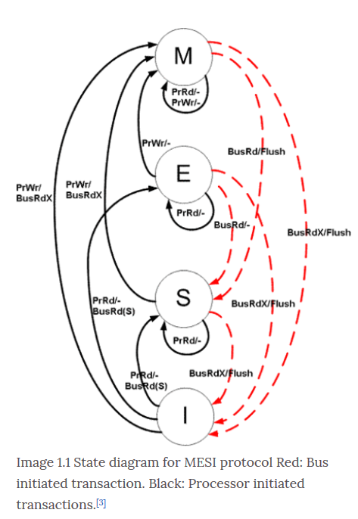

Slide 77
Snooping Operation: In a snooping system, all caches on the bus monitor (or snoop) all the bus transactions. Every cache has a copy of the sharing status of every block of physical memory it has stored. The state of the block is changed according to the State Diagram of the protocol used.(Refer image above for MESI state diagram). The bus has snoopers on both sides:
Snooper towards the Processor/Cache side.
The snooping function on the memory side is done by the Memory controller.

Slide 78
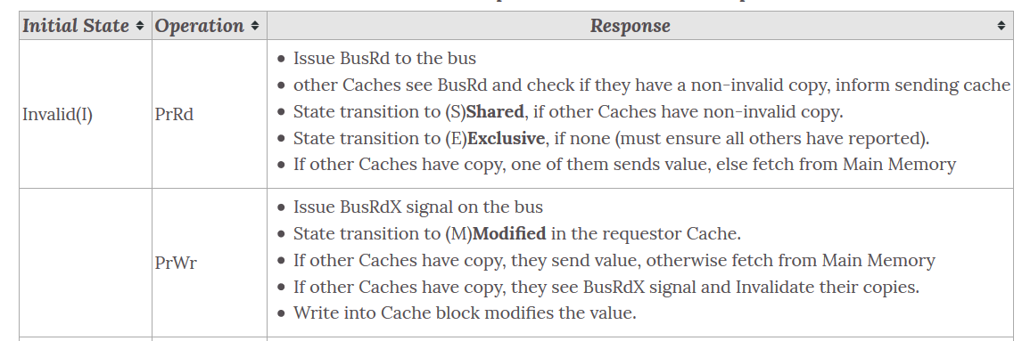
State Transitions and response to various Processor Operations

Slide 79


Slide 80
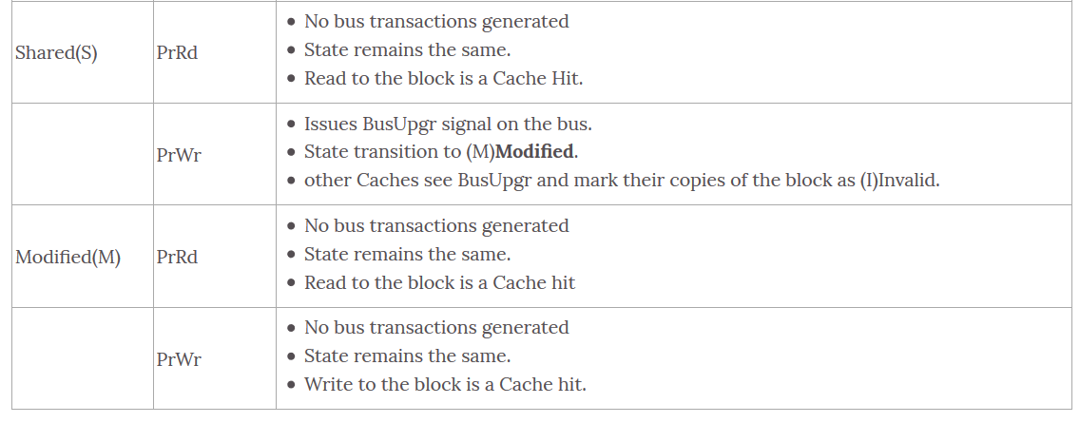

Slide 81
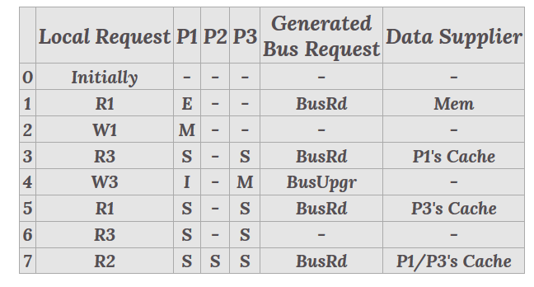
Illustration of MESI protocol operations
Let us assume that the following stream of read/write references. All the references are to the same location and the digit refers to the processor issuing the reference.
The stream is : R1, W1, R3, W3, R1, R3, R2.
Initially it is assumed that all the caches are empty.

Slide 82
Step 1: As the cache is initially empty, so the main memory provides P1 with the block and it becomes exclusive state.
Step 2: As the block is already present in the cache and in an exclusive state so it directly modifies that without any bus instruction. The block is now in a modified state.
Step 3: In this step, a BusRd is posted on the bus and the snooper on P1 senses this. It then flushes the data and changes its state to shared. The block on P3 also changes its state to shared as it has received data from another cache. There is no main memory access here.

Slide 83
Step 4: Here a BusUpgr is posted on the bus and the snooper on P1 senses this and invalidates the block as it is going to be modified by another cache. P3 then changes its block state to modified.
Step 5: As the current state is invalid, thus it will post a BusRd on the bus. The snooper at P3 will sense this and so will flush the data out. The state of the both the blocks on P1 and P3 will become shared now. Notice that this is when even the main memory will be updated with the previously modified data.
Step 6: There is a hit in the cache and it is in the shared state so no bus request is made here.
Step 7: There is cache miss on P2 and a BusRd is posted. The snooper on P1 and P3 sense this and both will attempt a flush. Whichever gets access of the bus first will do that operation.

